Slide 1


Green Pace
Security Policy Presentation
Developer: Joseph Dugan
The proposed Green Pace Security Policy consist of established implementation of secure principles to the developmental process. These policy approaches and methodologies must be maintained to ensure system protection.
Notes:
My name is Joseph Dugan, and this is my green pace security policy presentation. The proposed green pace security policy consists of established implementation of secure principles to the developmental process. These policy approaches and methodologies must be maintained to ensure system protection.

Slide 2

OVERVIEW: DEFENSE IN DEPTH
The Green Pace security policy consists of several applied principles, coding standards, threat assessments, and assistive automation tools to better protect applications from security vulnerabilities. The Defense in Depth illustration demonstrates our approach to establishing a variety of security layers to more effectively protect your application.
Notes:
The Green Pace security policy consists of several applied principles, coding standards, threat assessments, and assistive automation tools to better protect applications from security vulnerabilities. The Defense in Depth illustration demonstrates our approach to establishing a variety of security layers to more effectively protect your application.

Slide 3
THREATS MATRIX
Threats level is determined on likelihood of occurrence and overall threat level.
Other factors that impact these measurements such as the cost of solution implementation.
Likely Medium Risk | Priority High Risk
Low priority Low Risk | Unlikely Medium Risk
Notes:
The threat level of security vulnerabilities is determined by likelihood of occurrence and overall threat level. Simply put, the more severe the attack and the more likelihood of it occurring, the higher risk it becomes. Other factors may also impact these determined threat levels, such as cost of solution implementations.

Slide 4
10 PRINCIPLES
1. Validate Input Data – ensure correct data capture
2. Heed Compiler Warnings – Utilize dynamic and static analysis tools
3. Architect and Design for Security – Establish safeguards
4. Keep It Simple – Prevent an over complex design
5. Default Deny – Block non-permitted inbound and outbound traffic
6. Adhere to the Principle of Least Privilege – Access rights limitations
7. Sanitize Data Sent to Other Systems – Monitor, filter, clean
8. Practice Defense in Depth – layered security
9. Use Effective Quality Assurance Techniques - Test
10. Adopt a Secure Coding Standard – Utilize all security principles
Notes:
The 10 security principles consist of validate input data, heed compiler warnings, architect and design for security, keep it simple, default deny, adhere to the principle of least privilege, sanitize data sent to other systems, Practice Defense in Depth, use effective quality assurance techniques, and Adopt a secure coding standard.

Slide 5
CODING STANDARDS
1. STD-001-CCP – Do not cast to an out-of-range enumeration value
2. STD-002 –CCP – Use valid references, pointers, and iterators to reference elements of a container
3. STD-003-CCP – Guarantee that storage for string has sufficient space for character space for character data and the null terminator
4. STD-004-CCP – Do not store an already-owned pointer value in an unrelated smart pointer
5. STD-005-CCP – Properly deallocate dynamically allocated resources
6. STD-006-CCP – Use a static assertion to test the value of a constant expression
7. STD -007-CCP – Guarantee exception safety
8. STD-008-CCP – Avoid using default operator new for over-aligned types
9. STD-009-CCP – Handle all exceptions
10. STD-010-CCP – Range check element access
Notes:
The 10 coding standards consist of do not cast to an out-of-range enumeration value, do not cast to an out-of-range enumeration value, guarantee that storage for string has sufficient space for character space for character data and the null terminator, do not store an already-owned pointer value in an unrelated smart pointer, properly deallocate dynamically allocated resources, use a static assertion to test the value of a constant expression, guarantee exception safety, avoid using default operator new for over-aligned types, handle all exceptions, and range check element access.

Slide 6
ENCRYPTION POLICIES
Encryption in rest is the process of translating saved data to another form of data through encryption. This process allows for the protection of sensitive data and requires authorization to decode the encrypted information.
Encryption at flight is the process of encrypting data that is moving over a network. This policy is especially significant and beneficial in moving data when utilizing open internet. It protects sensitive data from being breached during a data transfer process.
Encryption in use is the process where data is never left unsecured regardless of its lifecycle stage (rest, at flight, or in use). Data access is monitored and controlled through authorization during this approach. Data requests are analyzed and responded to in real time allowing awareness of any suspicious activity.
Notes:
There are three types of encryption policies utilized within our approach. Encryption in rest is the process of translating saved data to another form of data through encryption. This process allows for the protection of sensitive data and requires authorization to decode the encrypted information. Encryption at flight is the process of encrypting data that is moving over a network. This policy is especially significant and beneficial in moving data when utilizing open internet. It protects sensitive data from being breached during a data transfer process. Encryption in use is the process where data is never left unsecured regardless of its lifecycle stage (rest, at flight, or in use). Data access is monitored and controlled through authorization during this approach. Data requests are analyzed and responded to in real time allowing awareness of any suspicious activity.

Slide 7
TRIPLE-A POLICIES
The authentication process is where users are confirmed through proper credentials (usernames, password, biometrics, etc.) to access a system. This policy is especially effective in controlling unauthorized access to user accounts.
The authorization process is where levels of access are determined for system users. Depending on what type of user is accessing the system, limitations to access can be established.
The accounting process is where system users are monitored and logged according to user interaction. This approach allows administrators to keep track of system components being accessed and how they are being interacted with.
Notes:
The triple-a policies consist of the authentication, authorization, and accounting processes. The authentication process is where users are confirmed through proper credentials (usernames, password, biometrics, etc.) to access a system. This policy is especially effective in controlling unauthorized access to user accounts. The authorization process is where levels of access are determined for system users. Depending on what type of user is accessing the system, limitations to access can be established. The accounting process is where system users are monitored and logged according to user interaction. This approach allows administrators to keep track of system components being accessed and how they are being interacted with.

Slide 8
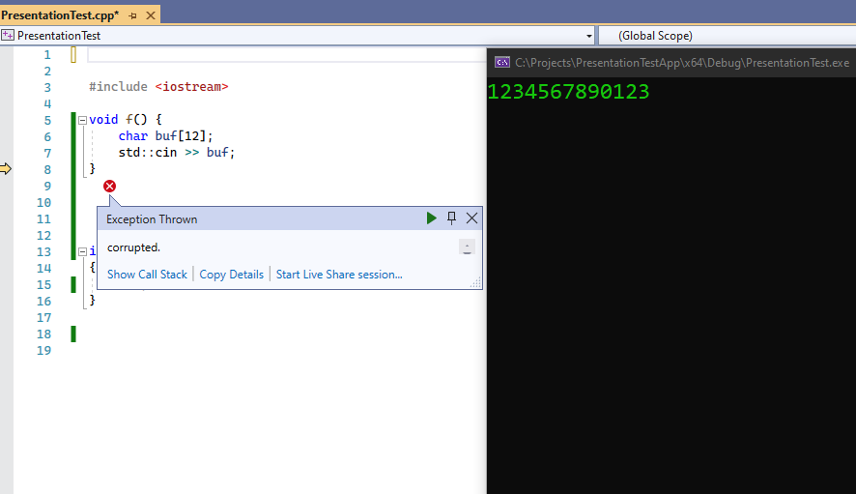
Coding Standard: Guarantee Sufficient Space
This test provided the importance of guaranteeing sufficient character space for strings.
The compiler threw an exception implying that the data had been corrupted.
Notes:
Back to our list of coding standards. This is an example of a test using non-compliant code that demonstrates the importance of guaranteeing sufficient space of characters for strings. As you can see, The example shows an exception being thrown due to the input being to large for the initialized variable.

Slide 9
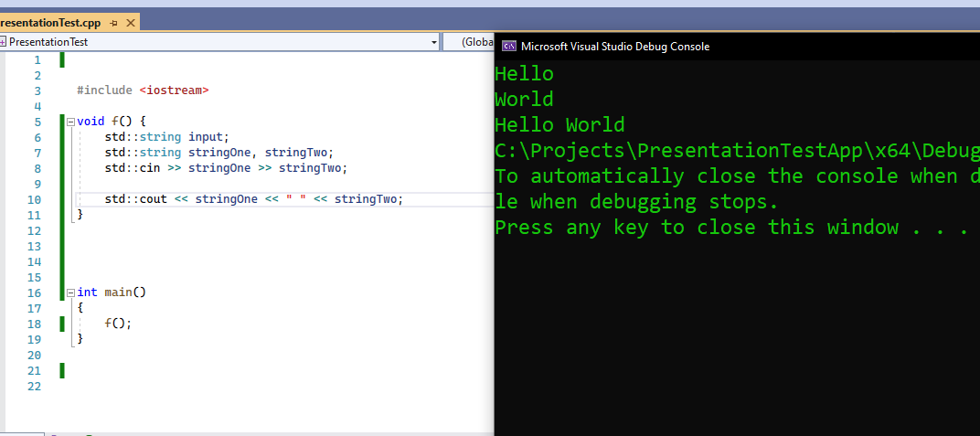
Coding Standard: Guarantee Sufficient Space
This compliant code test example demonstrates the correct approach to ensuring sufficient character space for strings.
This code compiled without errors or warnings and functioned correctly.
Notes:
This example demonstrates a test using the correct code to ensure sufficient space of characters for strings. As you can see a different data type was utilized and its size was not initialized before capturing the input.

Slide 10
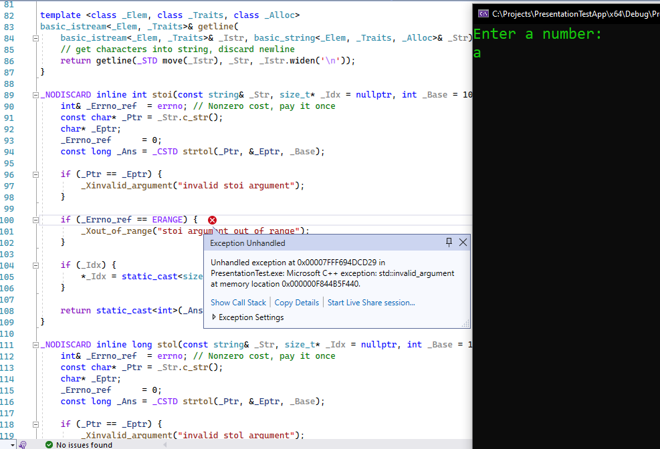
Coding Standard: Handle All Exceptions
This noncompliant code test provides an example of a user inputting an incorrect data type.
This application utilizes the “stoi” function to parse a string over to an integer.
Notes:
Moving on, This example demonstrates a test highlighting the importance of handling all exceptions. As you can see in the non-compliant code example, an invalid argument is thrown due to the user input. As you will see on the next slide, the stoi function is utilized to parse a string into an integer.

Slide 11
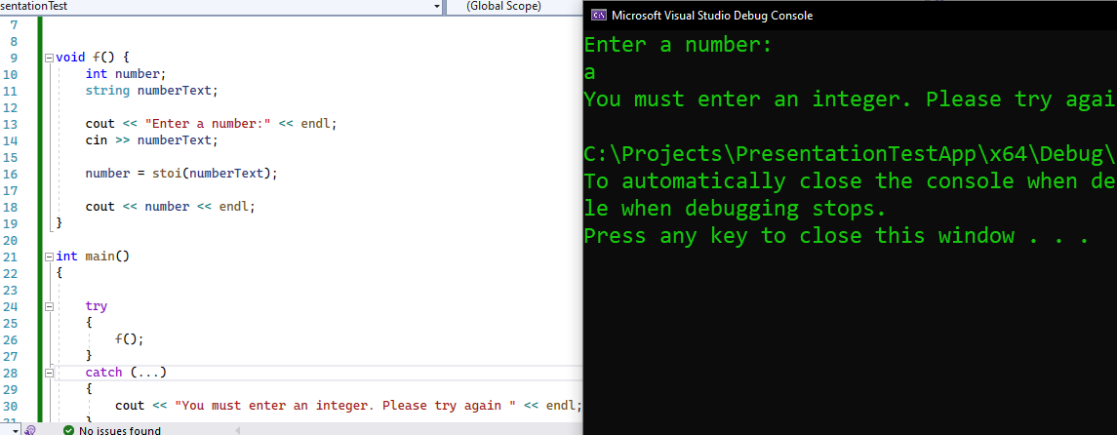
Coding Standard: Handle All Exceptions
Adding the try and catch statement handles all exceptions and catches the invalid argument when a non integer input is inputted.
Notes:
This example demonstrates the compliant code test of the same application that utilizes a try and catch statement to ensure user input is captured correctly.

Slide 12

AUTOMATION SUMMARY
Notes:
This is an illustration of the DevSecOps approach to development that we plan to implement.

Slide 13
TOOLS
The DevSecOps illustration provides a planned process of implementation for a system in development. This approach focuses on establishing system security as an integral asset in the developmental process. It allows for security principles to be established in the early stages of development resulting in a much more secure and functional system.
Several tools are utilized to ensure this DevSecOps approach. These tools consists of automation testing tools that scan for vulnerabilities, configure management tools, Alert for threats, and provide remediation.
Notes:
This approach focuses on establishing system security as an integral asset in the developmental process. It allows for security principles to be established in the early stages of development resulting in a much more secure and functional system. Several tools are utilized to ensure this DevSecOps approach. These tools consist of automation testing tools that scan for vulnerabilities, configure management tools, Alert for threats, and provide remediation.

Slide 14
RISKS AND BENEFITS
Some of the risks that are involved with this security approach is more cost due to the time handled in addressing security concerns. However, this can be countered by establishing core security principles within a team and utilizing automated DevSecOp’s testing tools.
The benefits in utilizing this security approach include a much more secure system, especially with the addition of applied defense in depth techniques. It also has the potential of cutting cost due to a consistent tested approach.
Notes:
Some of the risks that are involved with this security approach is more cost due to the time handled in addressing security concerns. However, this can be countered by establishing core security principles within a team and utilizing automated DevSecOp’s testing tools. The benefits in utilizing this security approach include a much more secure system, especially with the addition of applied defense in depth techniques. It also has the potential of cutting cost due to a consistent tested approach.

Slide 15
RECOMMENDATIONS
Communicating to a development team to establish these security principles is essential to this system’s success.
Security should be considered an integral part of the developmental process and should begin within the early stages.
Utilizing other security techniques with this security approach will provide even more protection.
Notes:
Communicating to a development team to establish these security principles is essential to this system’s success. Security should be considered an integral part of the developmental process and should begin within the early stages. Utilizing other security techniques with this security approach will provide even more protection.

Slide 16
CONCLUSIONS
Security principles must be established and practiced throughout an entire developmental team.
Adopting the perspective of security as an integral part of the developmental cycle is crucial.
Utilizing our encryption and triple-a policies will provide a much more secure system and prevent malicious activity.
Notes:
Security principles must be established and practiced throughout an entire developmental team. Adopting the perspective of security as an integral part of the developmental cycle is crucial. Utilizing our encryption and triple-a policies will provide a much more secure system and prevent malicious activity.

